Slide 1
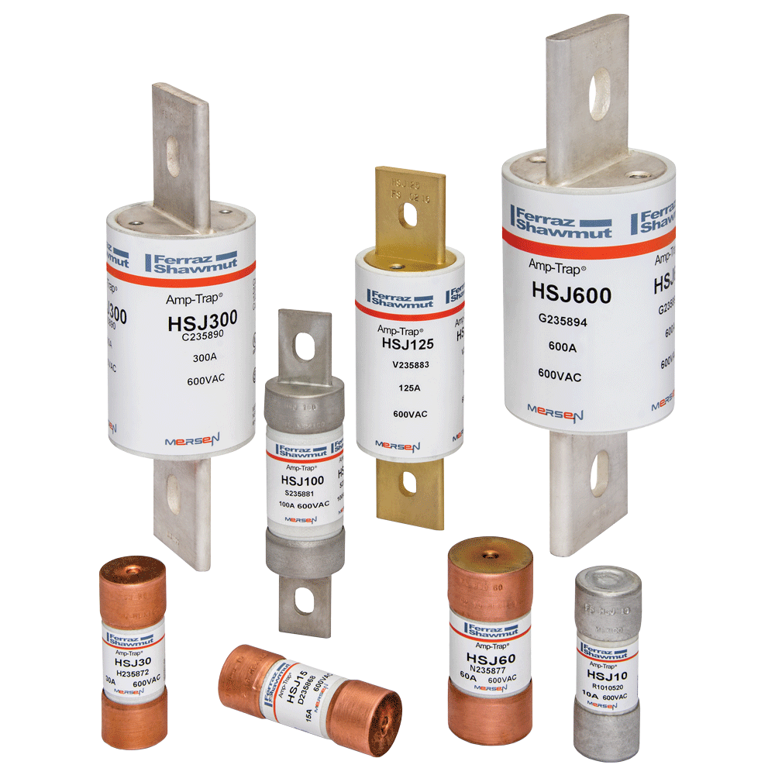
HSJ
High Speed J
A Mersen fuse family for OEMs,
End Users,
Panel Shops,
Facilities Engineers,
Maintenance Personnel,
MRO Accounts, and more!

Slide 2
Electronic Motor Control
With many motors in use, industry trend leads to energy savings and increased reliability.
Notes:
Be aware that a number of OEM’s - including ABB, Rockwell, Toshiba, and GE - are removing semiconductor fusing from their designs, and you run the risk of losing their business. (fade in: don’t allow OEM “economizing” to cost you business) Many recommend circuit breakers and UL-type fuses in their installation manuals. We need to work with their engineering and marketing groups (fade in: work with engineering and marketing groups) to include the new HSJ, and to explain the technical benefits their drives and soft-starters will gain by using our HSJ products. We need to actively work to generate applications information for all key OEM’s (fade in: generate applications information for key OEM’s - link part number to HSJ fuses) by linking their controller part numbers to the proper HSJ fuse in their installation and application manuals. Focus on type 1 and type 2 protection levels and offer lab time to test products to type 2 levels. (fade in: focus on type 1 & 2 protection. Offer lab time for type 2 product test levels.

Slide 3
Changing Trends in Electronic Motor Control
Electro Mechanical Starter
By-pass at Start
Soft-Starter
Drive

Slide 4
Changing Trends in Electronic Motor Control
Market for
Electronic
Controllers
is steadily growing
Notes:
Be aware that a number of OEM’s - including ABB, Rockwell, Toshiba, and GE - are removing semiconductor fusing from their designs, and you run the risk of losing their business. (fade in: don’t allow OEM “economizing” to cost you business) Many recommend circuit breakers and UL-type fuses in their installation manuals. We need to work with their engineering and marketing groups (fade in: work with engineering and marketing groups) to include the new HSJ, and to explain the technical benefits their drives and soft-starters will gain by using our HSJ products. We need to actively work to generate applications information for all key OEM’s (fade in: generate applications information for key OEM’s - link part number to HSJ fuses) by linking their controller part numbers to the proper HSJ fuse in their installation and application manuals. Focus on type 1 and type 2 protection levels and offer lab time to test products to type 2 levels. (fade in: focus on type 1 & 2 protection. Offer lab time for type 2 product test levels.

Slide 5



Leaders of Electronic Motor Controllers
Allen Bradley
ABB
Cutler Hammer
Square D
GE
Danfoss
Toshiba
Hitachi
AC Tech
Yaskawa
Notes:
Be aware that a number of OEM’s - including ABB, Rockwell, Toshiba, and GE - are removing semiconductor fusing from their designs, and you run the risk of losing their business. (fade in: don’t allow OEM “economizing” to cost you business) Many recommend circuit breakers and UL-type fuses in their installation manuals. We need to work with their engineering and marketing groups (fade in: work with engineering and marketing groups) to include the new HSJ, and to explain the technical benefits their drives and soft-starters will gain by using our HSJ products. We need to actively work to generate applications information for all key OEM’s (fade in: generate applications information for key OEM’s - link part number to HSJ fuses) by linking their controller part numbers to the proper HSJ fuse in their installation and application manuals. Focus on type 1 and type 2 protection levels and offer lab time to test products to type 2 levels. (fade in: focus on type 1 & 2 protection. Offer lab time for type 2 product test levels.

Slide 6
Cost Reduction of Electronic Motor Control
Manufacturers remove high speed fuse (Semiconductor fuse) from medium to low power Drives/Soft-starters (200HP and below)
Manufacturers suggest controller protection to comply with NEC using Circuit Breaker or UL listed fuses
Manufacturers justify removal of high speed fuse by arguing their system is self protected (IGBT)

Slide 7
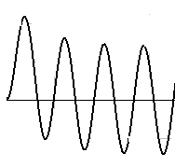
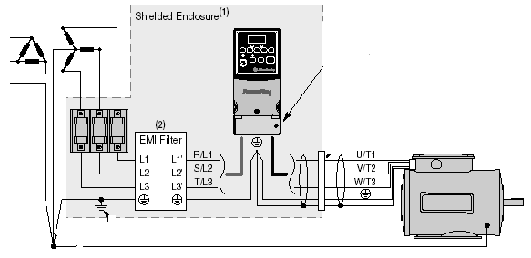
Preventing AC Drive Failure and Collateral Damage
Over-current protection comparison
Drives’ failures cause analyses
Introduction of a new fuse for drives

Slide 8
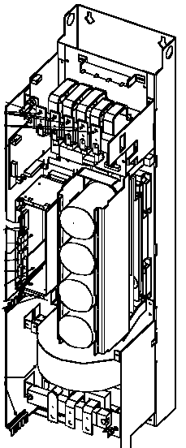
Preventing AC Drive Failure and Collateral Damage
AC drives are broken down to 3 operational blocks:
Rectifier converting AC to DC
DC Filter/Bus storing energy to be used as output power
Inverter (IGBT) converting DC to AC to feed motor

Slide 9
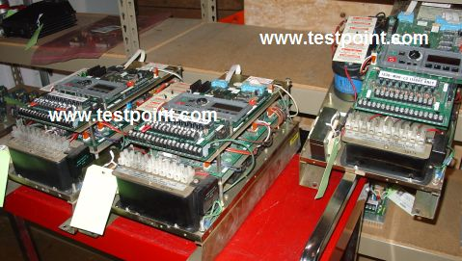
Preventing AC Drive Failure and Collateral Damage
Description of most dominant failure of AC Drives
Over-voltage condition caused
by high switching frequencies
will cause the drive to fail.
These transient over-voltages
can be caused by high switching
frequencies of drives themselves,
by inductive switching within a
facility, from poor power quality,
or by mother nature (lightning).
A Transient voltage higher than the IGBT max voltage rating will irreversibly damage the IGBT and eliminate its self-protection characteristics. In this condition the drive cannot shut down on its own.

Slide 10
Preventing AC Drive Failure and Collateral Damage
IGBT Module section
The IGBT is not a “fail-safe” component, i.e. if it fails (avalanche mode) it will leave the circuit in short circuit condition and allow the DC link capacitor bank to quickly discharge through the shorted IGBT
High fault current will lead to the melting of the bonding wire and cause the IGBT case to rupture
This case rupture will certainly ruin the drive and surrounding components
Only a high speed fuse can prevent this case rupture

Slide 11
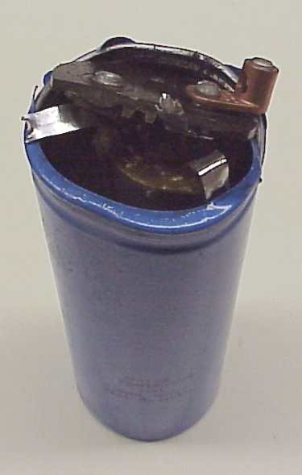
Preventing AC Drive Failure and Collateral Damage
DC Capacitor/Filter Section
Capacitors can be damaged from a shorted IGBT or when the internal dielectric can no longer withstand the applied voltage and breaks down. The result is a low impedance current path generating excessive heat and pressure that can cause violent case rupture.
The amount of physical damage is relative to the amount of energy stored and how fast the capacitor is charged or discharged.
Only a high speed fuse on the AC line side can limit the potential damage.

Slide 12
Preventing AC Drive Failure and Collateral Damage
Rectifier Section
The rectifier section of an AC drive is built with either diodes or SCRs. Rectifiers have a good withstand to transient over-voltage but are very susceptible to over-current (short circuits).
In the event of an internal fault condition due to a faulty components within the AC drive, the rectifier will be subject to damaging current levels
Only a high speed fuse will protect the rectifier section

Slide 13
Preventing AC Drive Failure and Collateral Damage
Description of Most Dominant Failure of AC Drives
During a short circuit fault, only a high speed fuse will limit the amount of energy rushing into the drive and isolate the damage at the component level.
Using a high speed fuse protects components and equipment from a violent rupture if a short circuit occurs. The end user will only need to swap drives facilitating maintenance and reducing down time. The failed drives could be repaired.
A high speed fuse lowers the possibility of personal injury from conditions such as arc flash.

Slide 14
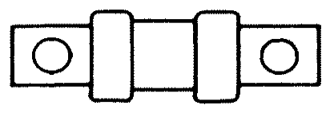
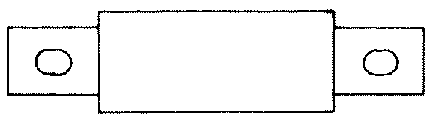
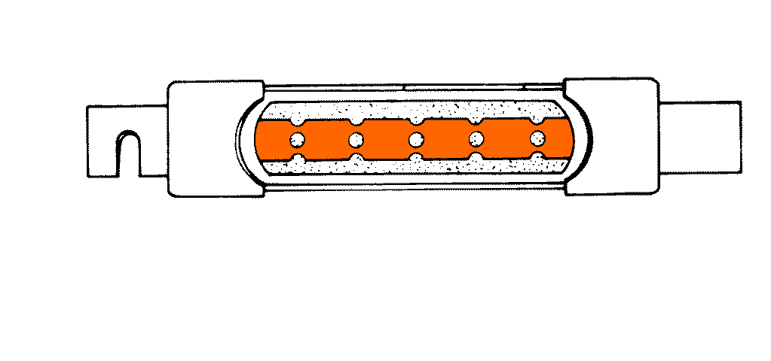
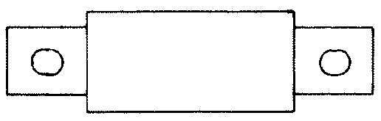
Preventing AC Drive Failure and Collateral Damage
Typical fuse protection suggested by manufacturers
Class T
Fast acting / no time delay
Class J
Fast acting or time delay
Class R
Fast acting or time delay
Semiconductor
Ultra rapid / high speed
I²t comparison 200A fuse
Class T Class J RK5 Semi-F
150kA²s 300kA²s 1600kA²s 78kA²s

Slide 15
Preventing AC Drive Failure and Collateral Damage
Over-Current Protection Comparison
Circuit Breaker
For the same fault condition, the traditional branch circuit protection devices, such as circuit breakers and fuses (Class T, J, RK…) are restricted in their capability to limit the amount of thermal energy
They will not protect the input rectifier, eliminate capacitor rupture or isolate a faulty IGBT
Let-Through Current
Traditional Branch Fuse
High Speed Fuse
Time

Slide 16
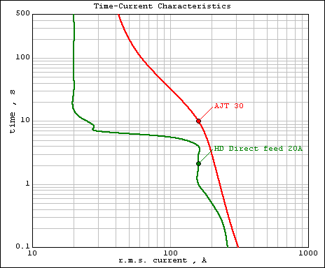
Preventing AC Drive Failure and Collateral Damage
Over-Current Protection Comparison
FLA
Electro Mechanical start showing the fuse inrush withstanding requirement.
UL Listed Class J (TD)
Electro Mechanical Starter 20A
Inrush

Slide 17
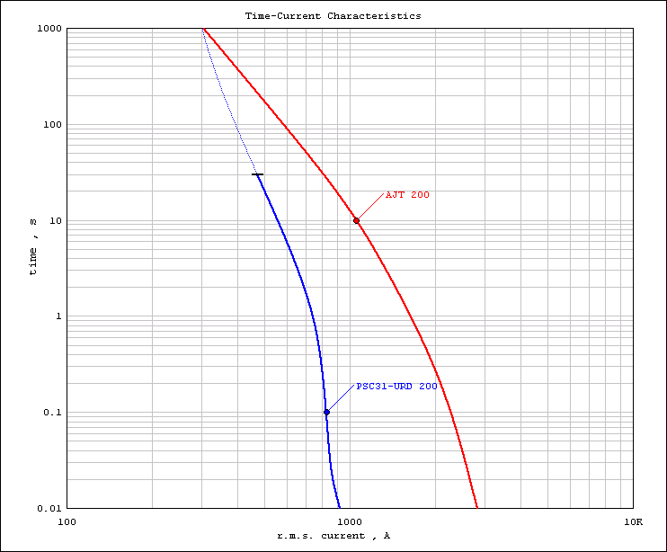
Preventing AC Drive Failure and Collateral Damage
Over-Current Protection Comparison
High speed semiconductor fuses do not provide overload protection and do not withstand inrush current.
Over-Load
Inrush

Slide 18
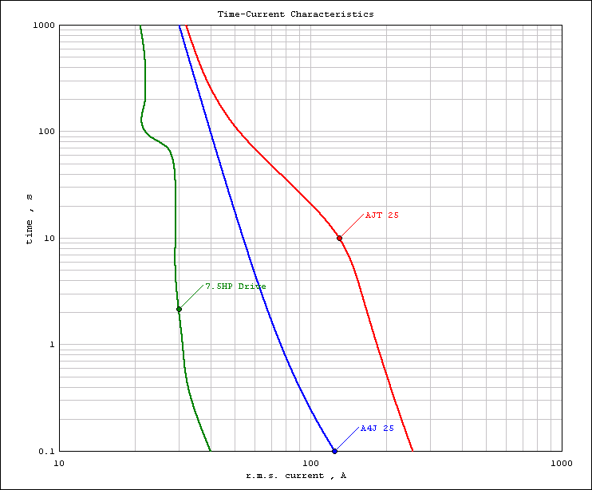
Preventing AC Drive Failure and Collateral Damage
Over-Current Protection Comparison
FLA
Class J TD provides high inrush capability that is unnecessary for Drives
& Soft-Starters
With an electronic motor control, the inrush current has significantly decreased.
Inrush

Slide 19
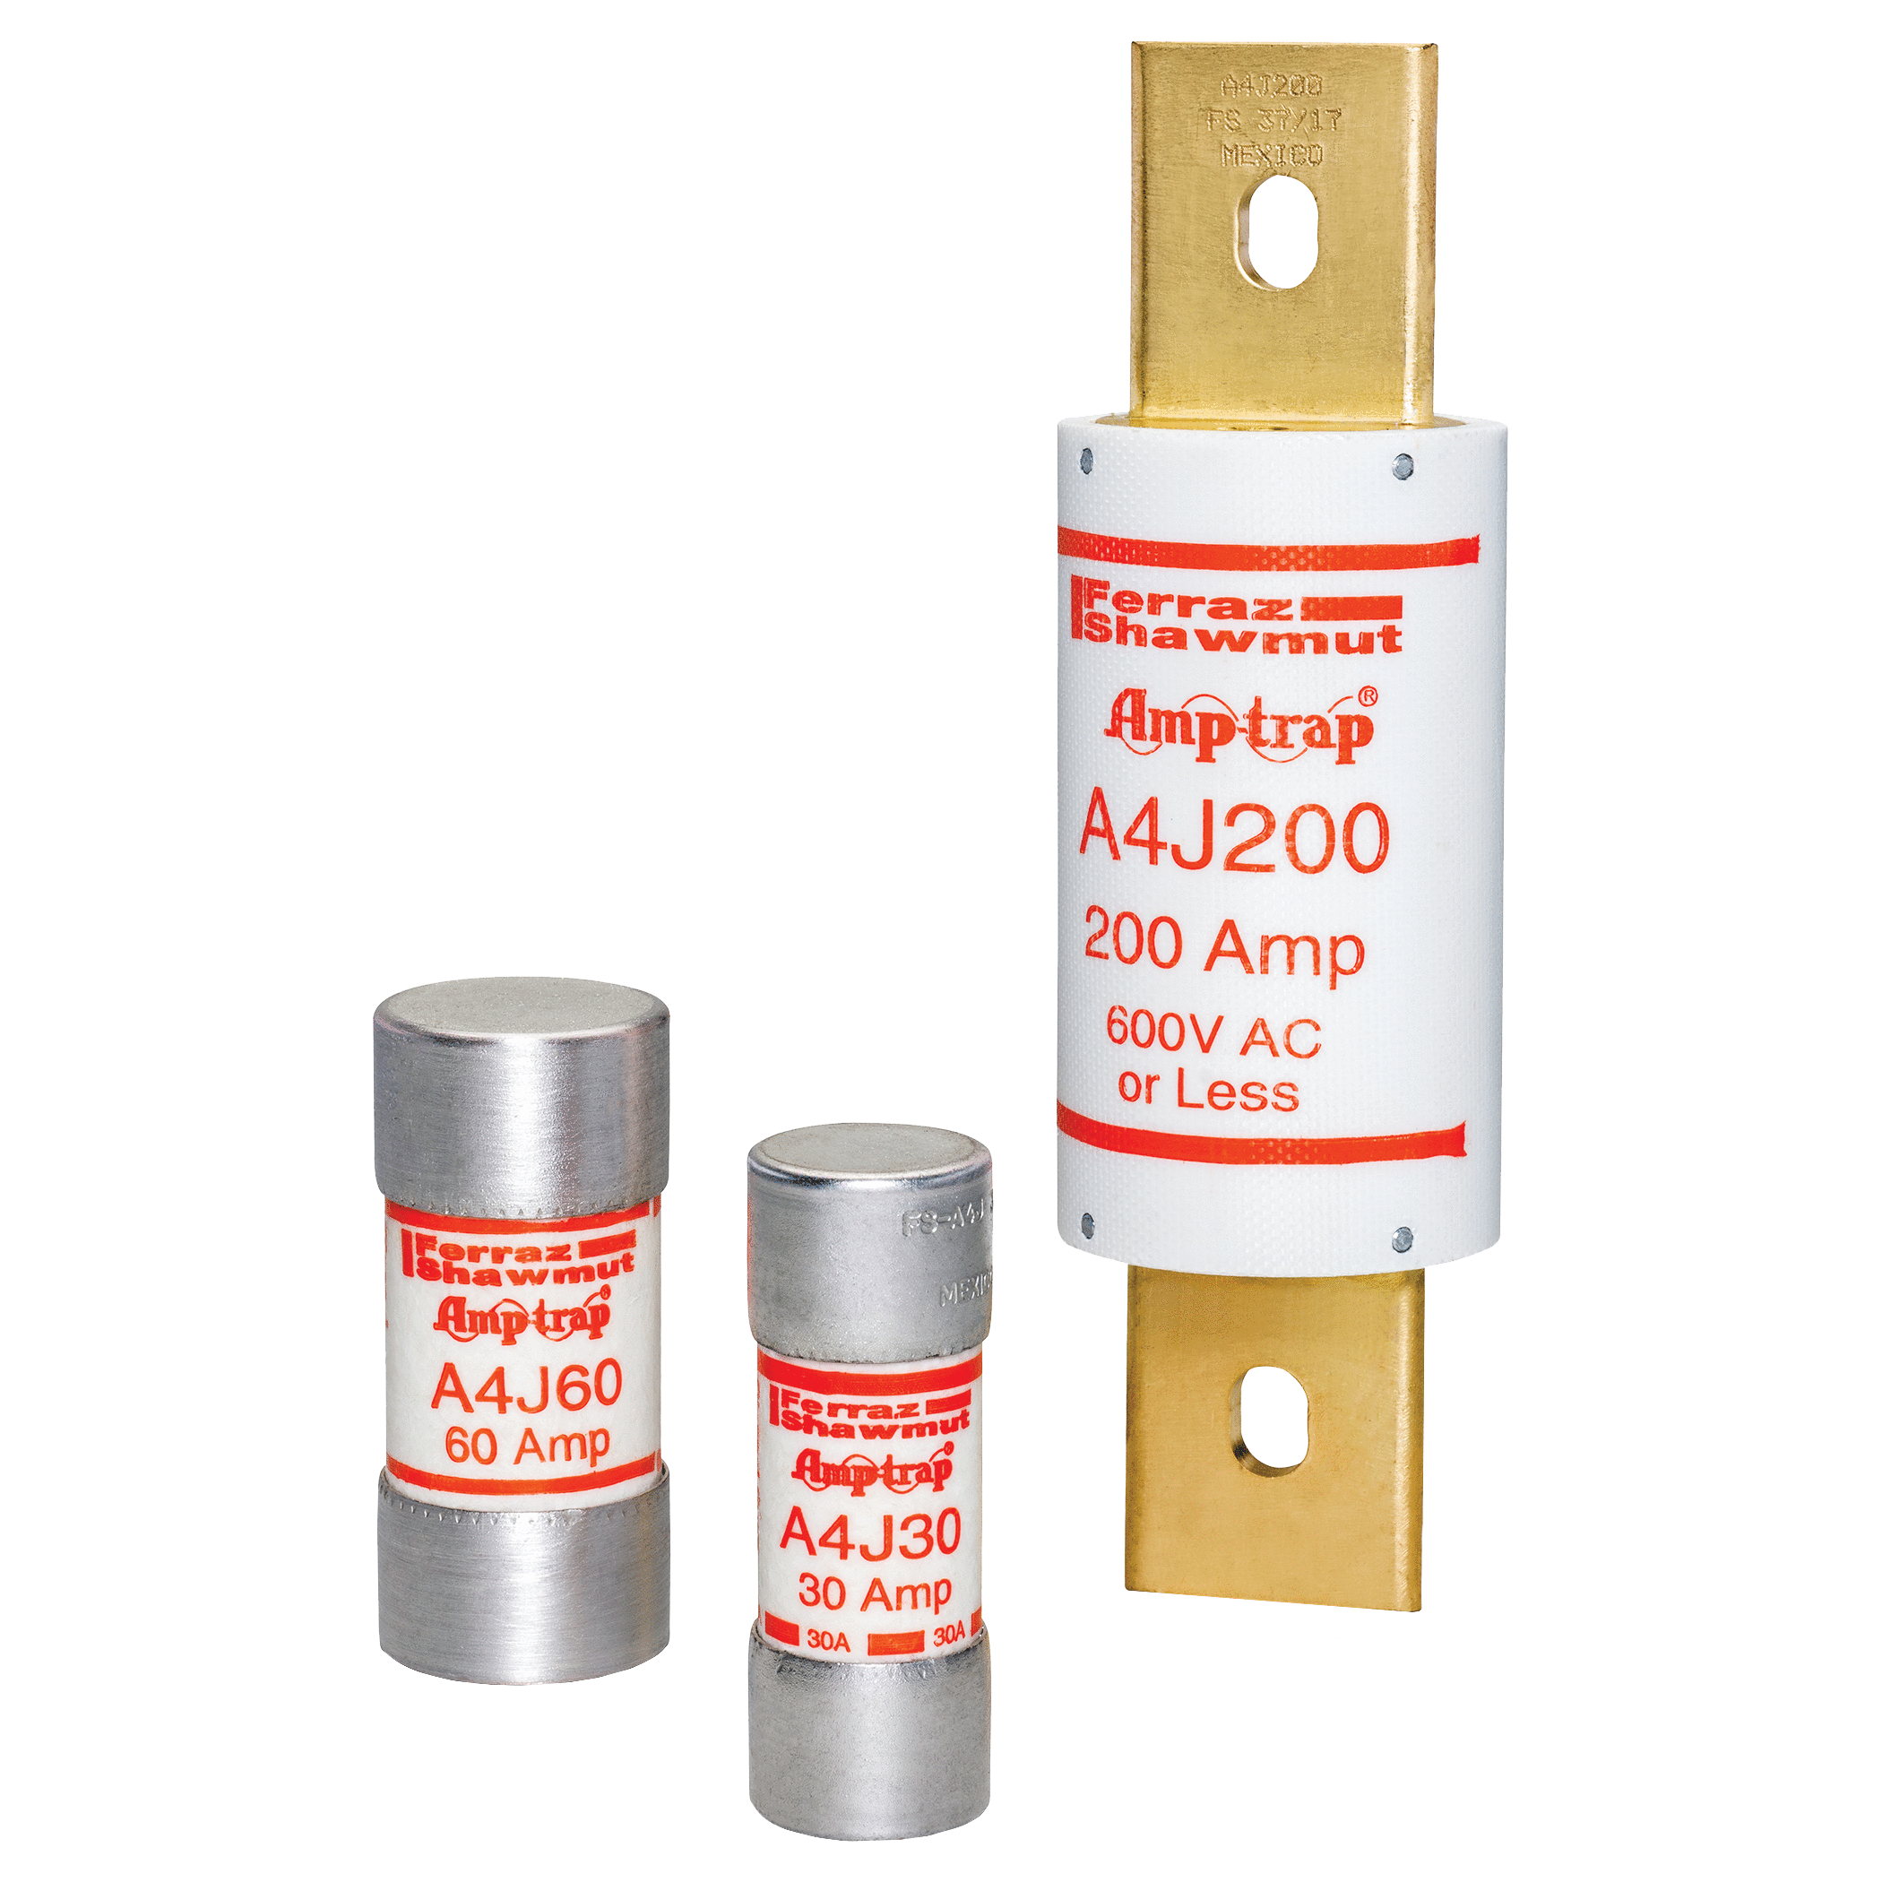
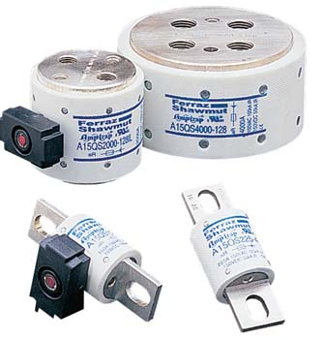
The Solution: A Fuse for Drives and Soft Starters
High Speed Class J (HSJ)
Class J
+
=
High Speed

Slide 20
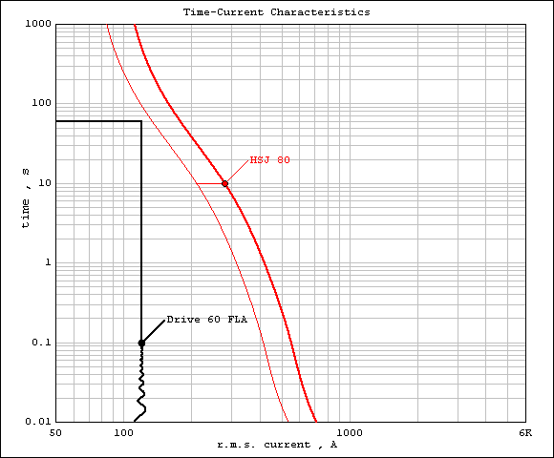
The HSJ Solution: A Fuse for Drives
The HSJ fuse line has melting curves that mirror the starting parameters of drives and also provides energy limitation to protect sensitive power electronics.
Inrush requirements…
  AC Drives: 200% FLA for 60 sec
  (every 5 min for 1 hour)
  Soft-Starters: 450% FLA for 15 sec
  (Every 10 min for 10 times per day)
Starting characteristic of Drive

Slide 21
The HSJ Solution
HSJ Has Lower Let-Through Current
The HSJ can provide short-circuit protection comparable to semiconductor fuses
Let-Through Current
Time

Slide 22
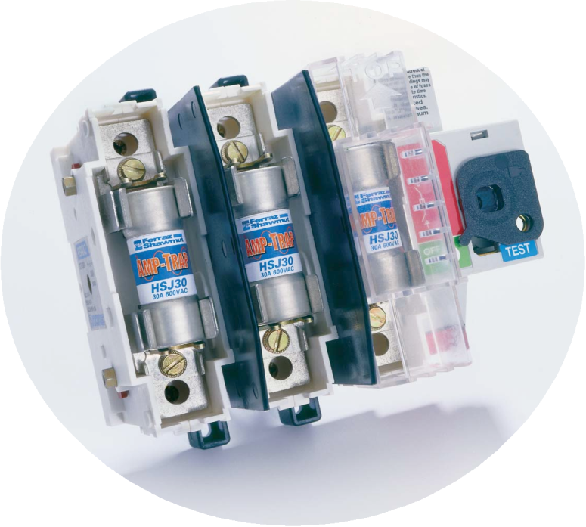
The HSJ Solution
High-speed performance protects sensitive power semiconductors
Complies with NEC requirements for branch circuit protection
Notes:
Mersen is pleased to introduce the High Speed Class J (HSJ) product line. The HSJ was designed with two primary goals:
• to provide the high-speed performance required to protect sensitive power semiconductors, such as diodes, SCR’s GTO’s, and solid-state relays (fade in: high speed performance protects sensitive power semiconductors)
• to comply with National Electrical Code requirements to provide branch circuit protection (fade in: complies with NEC requirements for branch circuit protection)

Slide 23
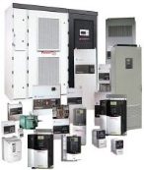
The HSJ Solution
Features and Benefits
  UL listed to 248-8
  UL Class J dimension
  CSA certified to C22.2
  600VAC/500VDC
  15A to 600A
  200kA interrupting rating
  Very low I²t
  Easily coordinated with drives and soft starters
Notes:
• ΥΛ Λιστεδ το 248−8
Τηε ΗΣϑ μεετσ αλλ ελεχτριχαλ ανδ μεχηανιχαλ ρεθυιρεμεντσ φορ ΥΛ248−8 λιστινγ ωηιχη μεανσ τηε φυσε χαν βε υσεδ ασ α βρανχη χιρχυιτ προτεχτιον δεϖιχε. Τηισ ισ α χοδε ρεθυιρεμεντ φορ τηε Υ.Σ.
• UL Class J Dimension
The HSJ is designed with the UL class J dimension. This allows the fuse to used in ready available Ultra Safe holders, Clips and blocks.
• CSA certified to C22.2
The HSJ meets all electrical and mechanical requirements for C22.2 approval which means the fuse can be used as a branch circuit protection device. This is a code requirement for Canada.
• 600VAC / 500VDC
The HSJ can be used on systems that have AC voltages up to 600VAC and DC voltages up to 500VDC
• 15A to 600A
Current ranges for the HSJ go from 15A to 600A. These ranges cover the vast majority of applications that require a very fast acting fuse for AC/DC Drives, AC/DC Soft Starters and Solid State relays.
• 200kA Interrupting rating
Just as with all other class J fuses from Mersen, the HSJ has an interrupting ability of 200,000A which means it can be used as a branch circuit protection device at locations that have up to 200,000A of available current.
• Very Low I²t
The HSJ is designed to withstand the normal starting conditions of electronic motor controllers and provide very fast performance during a short circuit condition. The HSJ has very low I2t in-order to provide protection to Diode & Thyristor technology devices. Because of this very low I2t, the HSJ will provide an even higher level of protection to series components such as contactors and over-load relays..allowing these devices to be used at locations that exceed the ratings that were achieved when using tradition branch circuit devices.
• Can be easily coordinated with Drives & Soft-Starters
The manufacturers of electronic motor controllers provide standardized branch circuit recommendations based on code requirements and electrical operating conditions. These tables provide a class type of fuse and a current rating based on the model of controller, the HSJ meets and exceeds the recommendations based on fast Acting class J and T fuses. The HSJ can easily be interchanged with approved recommendations from manufacturers and will not cause any warranty of equipment issues. (show sample table again)

Slide 24
Preventing AC Drive Failure and Collateral Damage
Limitations of Traditional Circuit Protection
Circuit breakers will provide
NEC code compliance, but no
high-speed protection for
internal power electronics
Using older UL listed fuses
will meet NEC code compliance,
but will provide limited
protection to internal power electronics
Semiconductor fuses alone
provide high-speed protection
for internal electronics, however - although UL component recognized, they are not UL listed class fuses and will not provide NEC code compliance
Protection Method
Circuit Breaker
(UL Listed)
Class J, T, RK1
RK5 Fuse (UL Listed)
Semiconductor Fuse
(UL Rec)
NEW HSJ
(UL Listed)
Code Branch
Circuit
Protection
Drive or
Soft-Starter
Protection
Notes:
Many new drive or controller applications have been wired using traditional circuit breakers to provide protection. Be aware of the limitations this method poses to your equipment; for example - using semiconductor (high-speed fuses); UL listed class fuses (RK1, RK5, and J); or circuit breakers.
• Semiconductor fuses alone provide high-speed protection for internal electronics and, although UL component recognized, they are not a UL listed class fuse sand will not provide NEC code compliance.
• Using older UL listed fuses will meet NEC code compliance, but will provide limited protection to internal power electronics.
• Circuit breakers will provide NEC code compliance, but no high-speed protection for internal power electronics.

Slide 25
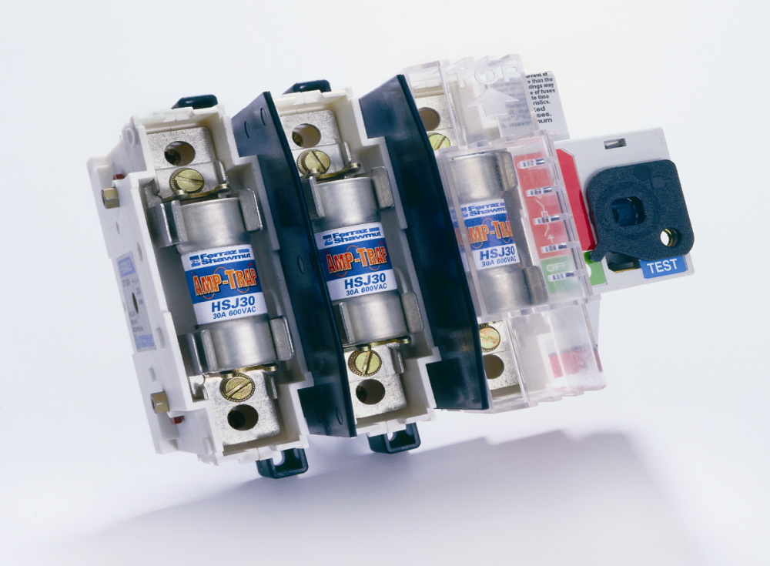
The HSJ “Hybrid” Approach
Mersen HSJ Fused Switch Combination
The best fault protection and code compliance available.
Superior cost-effective solution to inadequate circuit breakers.
Competition has fast-acting Class J but with 60-70% Higher I²t than Mersen HSJ.

Slide 26
Rule of Thumb to Size the HSJ
Based on FLA
  For drives with IGBT
    1.3 to 1.5 times FLA
  For soft starters (diodes or SCRs)
    1.5 to 2 times FLA
OR
Based on Max I for 60 Sec.
  1.1 times I for normal duty
  1.5 times I for heavy duty
Notes:
Be aware that a number of OEM’s - including ABB, Rockwell, Toshiba, and GE - are removing semiconductor fusing from their designs, and you run the risk of losing their business. (fade in: don’t allow OEM “economizing” to cost you business) Many recommend circuit breakers and UL-type fuses in their installation manuals. We need to work with their engineering and marketing groups (fade in: work with engineering and marketing groups) to include the new HSJ, and to explain the technical benefits their drives and soft-starters will gain by using our HSJ products. We need to actively work to generate applications information for all key OEM’s (fade in: generate applications information for key OEM’s - link part number to HSJ fuses) by linking their controller part numbers to the proper HSJ fuse in their installation and application manuals. Focus on type 1 and type 2 protection levels and offer lab time to test products to type 2 levels. (fade in: focus on type 1 & 2 protection. Offer lab time for type 2 product test levels.

Slide 27
Application Notes/Alerts
Two considerations to know about the by-pass option
It is important to understand typical options provided with electronic motor controllers. The option that most directly effects the fuse selection is the “Bypass Option.”
  By-pass electronic controller at start-up
  By-pass electronic controller during operation
Notes:
(1)The manufacturers who offer bypass-mode options in their equipment for those applications where there are critical loads, e.g., medical or waste-water. This option is normally provided as a pre-packaged panel. When the drive or soft-starter are bypassed at start-up due to controller failure, the power is fed directly to load(motor), generating a high in-rush current that requires a very slow acting fuse/CB such as a Time delay fuse(show graph A). The HSJ is not suited for direct start applications just as traditional fast acting fuses are not.
(2)The manufacturers who offer by-pass mode that by-passed equipment after equipment is started and operating under full load current(show graph B). This by-pass option offers users a substantial energy savings because the by-pass mechanism (mechanical contactor or electronic switch) eliminates the power losses needed to keep internal electrics operating. The HSJ is suited very well for this by-pass option because there is very little withstand of in-rush current at start.

Slide 28
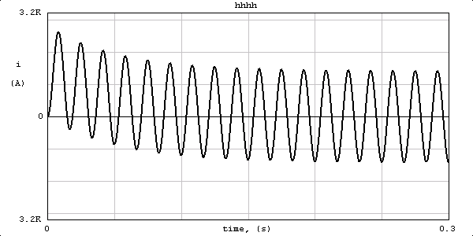
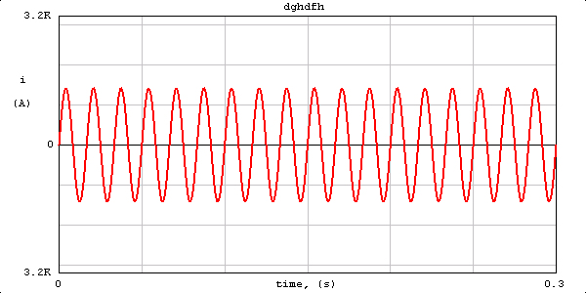
Application Notes/Alerts
The HSJ is not suited for bypass electronic controller at start-up operation
Bypass at start-up
The HSJ is very well suited for bypass electronic controller during operation after the equipment is started and operating at full load current
Bypass during operation

Slide 29
To Learn More…
The HSJ provides the performance needed for today’s electronic motor controllers. A clear understanding of the motor controller is key to selling the benefits of the HSJ.
For more information about our new line of High Speed J products visit ep-us.mersen.com, contact your Mersen representative, or call us today at 978-462-6662.

