Slide 1
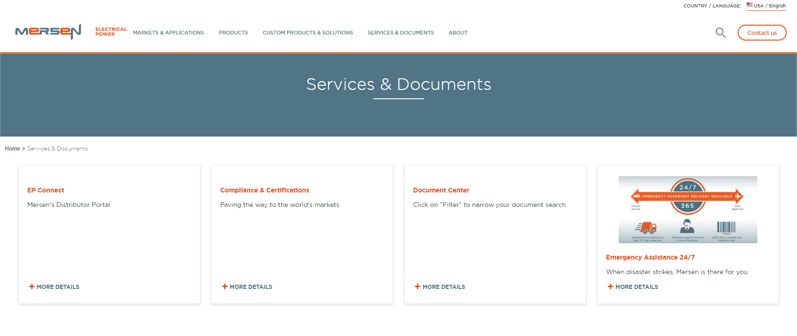
Document Center
Select “Services & Documents” and navigate to “Document Center”

Slide 2
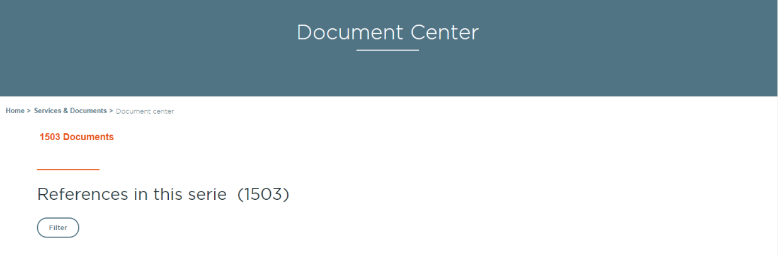
Document Center
Click “Filter” to narrow the search for the document you want

Slide 3
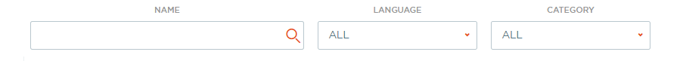
Document Center
Ways to filter – you can use one, two, or three categories:
  Type in the document name or words in document title
    Use quotation marks to narrow your search, such as “High Speed Fuses”
    Try to choose a unique word in the title of your document. “Fuses” will produce many responses!
  Choose the language that the document is in
  Select what category of document you have from pull-down menu
    Categories include brochures, charts, drawings, etc.

Slide 4
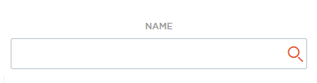

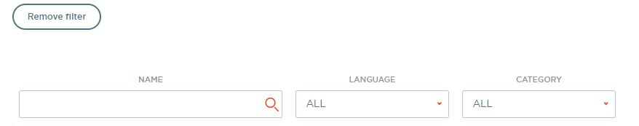
Document Center
Click “Enter” on keyboard or
click on magnifying glass to
initiate search and display results
Click download button to download document.
Remember to remove the filters before starting your
next search (or your new search will reflect your
old search criteria)

