Slide 1

Session 2:
Product Overview

Slide 2
Agenda
UL/CSA low voltage product offering
Medium voltage product offering
Semiconductor/Highspeed product offering
UL/CSA low voltage disconnect switches
Wire management
EV & Energy Storage product offering
Engineered products cooling/bus bar

Slide 3



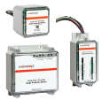
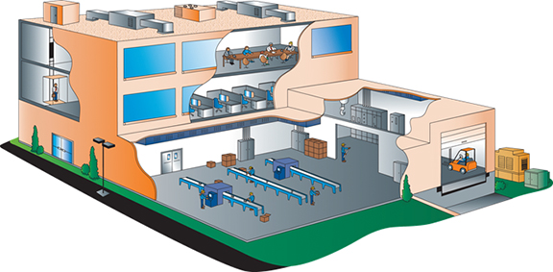
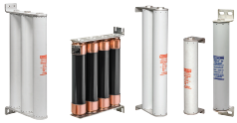

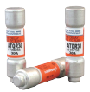
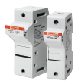

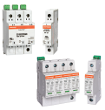

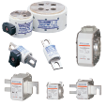

Product Overview
Switchgear/Motor Control
Class L Fuses, Class J Fuses, Class T Fuses, Surge Protective Devices
Distribution Network/Back-Up Generator
Class J Fuses, Medium Voltage Fuses, Cable Protectors
Industrial Controls
Specialty Products
Class CC Fuses; UltraSafeTM Fuse Holders; ClassJ, RK1, T Fuses; Surge Protective Devices
In-Line Fuse Holders, Forklift Truck Fuses, High-Speed Fuses & Holders

Slide 4
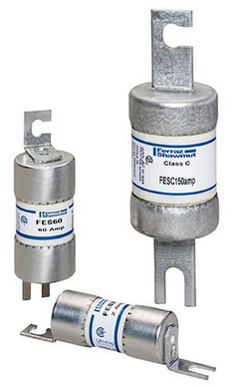
UL/CSA Low Voltage Fuse Offering
Class C
(248-2)

Slide 5
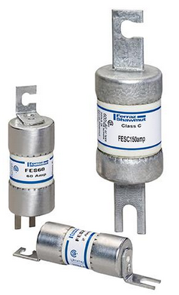
CSA Class C fuses
  Rated up to 2-600A, 200kA IR
  Fast Acting
  Exact replacement for British Standard (BS88) and older HRCII-C type fuses
  Different mounting dimensions and performance ratings available.
Series | Volts | Performance | Application
FES | 600VAC/460DC | Fast-Acting | Short circuit and back-up protection of motor controllers and components
FESC | 600VAC/450DC
FESF | 600VAC/450DC

Slide 6
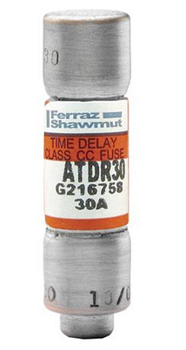
UL/CSA Low Voltage Fuse Offering
Class C
(248-2)
Class CC
(248-4)
Notes:
What is the only UL fuse class to have ampere ratings up to 6000A?
What is the maximum defined ampere rating of a Class CC?
What is the difference between a Class R fuse and a Class K fuse?
What fuse line is renewable?

Slide 7
UL/CSA Class CC Fuse Offering
Class CC Fuses
  Rated 30A or less, 200kA IR
  Current-Limiting, Optional Time-Delay
  All size 10x38mm with rejection feature
  UL Listed for Branch-Circuit Protection
Series | Volts | Performance | Application
ATDR | 600VAC / 300VDC | Time-Delay | Motor protection
ATQR | 600VAC / 300VDC | Time-Delay | Transformer protection
ATMR | 600VAC/DC | Fast-Acting | Control, lighting, general purpose protection

Slide 8
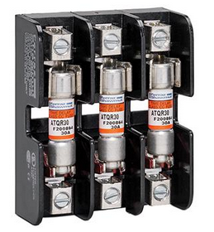
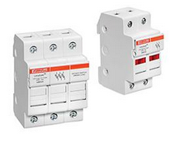
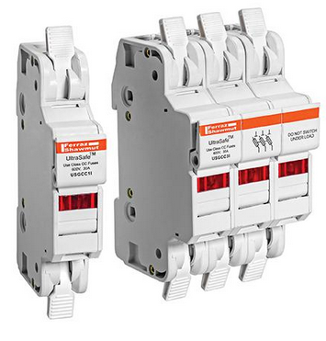
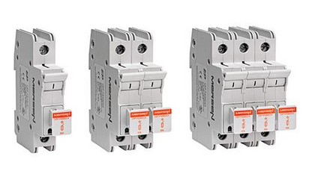
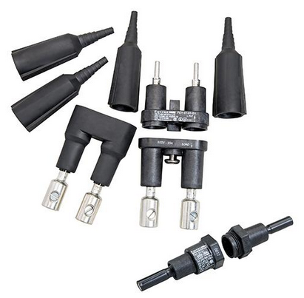
UL/CSA Class CC Fuse Holders
303XXR
USCC
USGCC
In-Line FEC/FEY
CEP-FS30CC

Slide 9
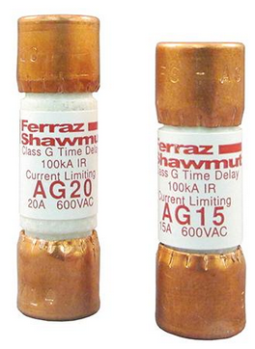
UL/CSA Low Voltage Fuse Offering
Class C
(248-2)
Class CC
(248-4)
Class G
(248-5)

Slide 10
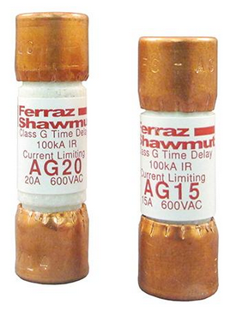
UL/CSA Class G Fuse Offering
  Rated up to 60A, 200kA IR
  600VAC (1/2 to 20A), 480VAC (25 to 60A)
  Current-Limiting, Time-Delay (5A and up)
  Four physical sizes
  UL Listed for Branch-Circuit Protection
Series | Volts | Performance | Application
AG | 600VAC / 300VDC | Time-Delay | Lighting, Heating, & Appliance

Slide 11
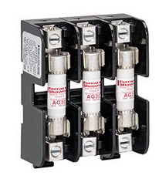
UL/CSA Class G Fuse Holders
40XXXG
In-Line FEG-21-21

Slide 12
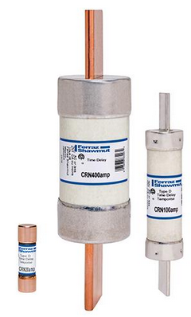
UL/CSA Low Voltage Fuse Offering
Class C
(248-2)
Class H (non renewable)
(248-6)
Class CC
(248-4)
Class G
(248-5)

Slide 13
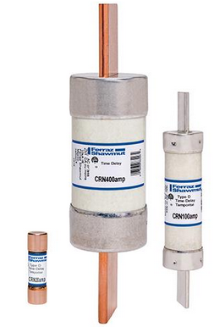
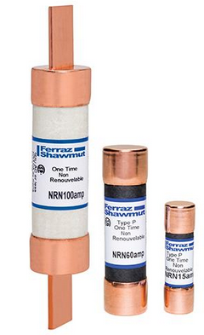
UL/CSA Class H Non-Renewable Fuse Offering
  Rated 600A or less, 10kA I.R.
  Not Current-Limiting
  Sizes vary by ampere rating
  No rejection feature
  Meet Canadian Electrical Code requirements for Type D and Type P melt time
Series | Volts | Performance | Application
CRN | 250VAC | Type D
CRS | 600VAC
NRN | 250VAC | Type P | Loadcenters, panelboards, switchboards, bus duct, feeders, lighting
NRS | 600VAC

Slide 14
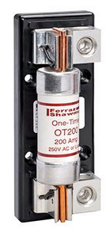

UL/CSA Class H Fuse Holders
20XXX & 60XXX
https://ep-us.mersen.com/products/series/class-hk-250v-fuseholders-class-h-k

Slide 15
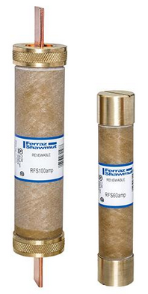
UL/CSA Low Voltage Fuse Offering
Class H (non renewable)
(248-6)
Class H (renewable)
(248-7)
Class C
(248-2)
Class CC
(248-4)
Class G
(248-5)

Slide 16
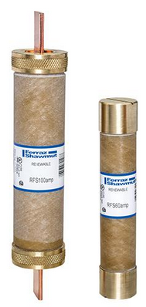
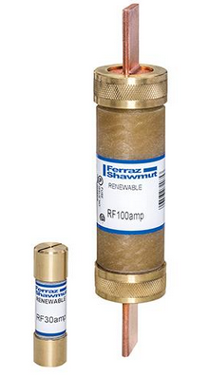
UL/CSA Class H Renewable Fuse Offering
  Rated 600A or less, 10kA I.R.
  Not Current-Limiting
  Sizes vary by ampere rating
  No rejection feature
  Replaceable fuse links
Class H fuses of the renewable type shall be permitted to be used
only for replacement in existing installations where there is no
evidence of overfusing or tampering (NFPA 70, Article 240.60 [D]).
Series | Volts | Performance | Application
RF | 250VAC | Fast-Acting | Existing
RFS | 600VAC

Slide 17
UL/CSA Class H Fuse Holders
20XXX & 60XXX
https://ep-us.mersen.com/products/series/class-hk-250v-fuseholders-class-h-k

Slide 18
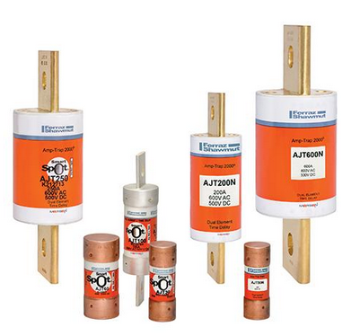
UL/CSA Low Voltage Fuse Offering
Class H (non renewable)
(248-6)
Class H (renewable)
(248-7)
Class C
(248-2)
Class CC
(248-4)
Class G
(248-5)
Class J
(248-8)

Slide 19
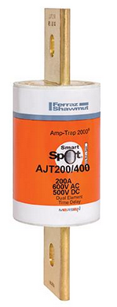
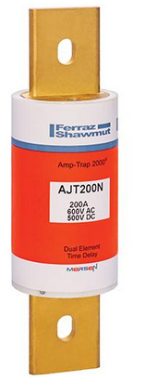
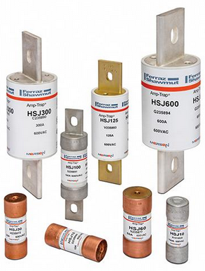
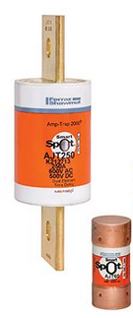
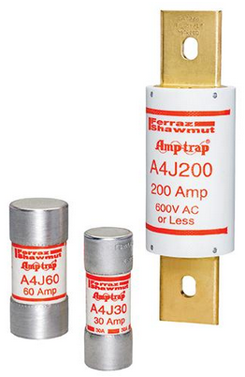
UL/CSA Class J Fuse Offering
  Rated 600A or less, 200kA I.R.
  Current-Limiting
  Sizes vary by ampere rating
  Rejection by Size
  UL Listed for Branch-
  Circuit Protection
  Class J Reducer fuse
  AJT non indicating fuse AJT(N)
Series | Volts | Performance | Application
AJT | 600VAC/500VDC | Time-Delay | Motor, transformer, main, feeder
A4J | 600VAC/300VDC | Fast-Acting | Panelboard, loadcenter, switchboard
HSJ | 600VAC/500VDC | Semiconductor | Drive, soft-starter, solid state relays

Slide 20
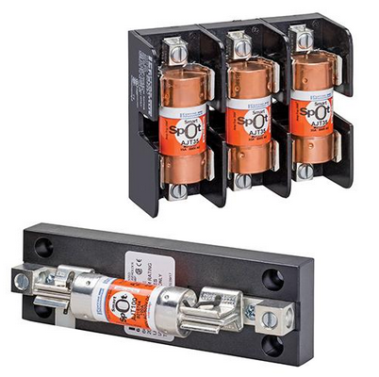
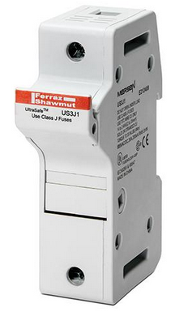
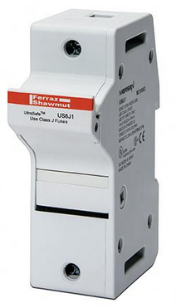
UL/CSA Class J Fuse Holders
Open Blocks
US3J
US6J
https://ep-us.mersen.com/products/series/class-j-fuseholders-class-j
https://ep-us.mersen.com/products/series/us3j-class-j
https://ep-us.mersen.com/products/series/us6j-class-j

Slide 21
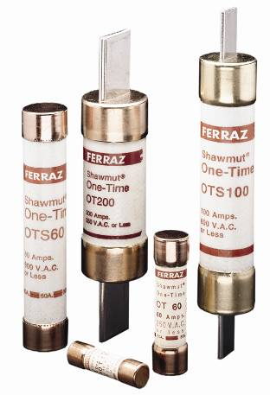
UL/CSA Low Voltage Fuse Offering
Class H (non renewable)
(248-6)
Class H (renewable)
(248-7)
Class C
(248-2)
Class CC
(248-4)
Class G
(248-5)
Class J
(248-8)
Class K
(248-9)

Slide 22
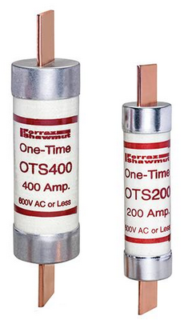
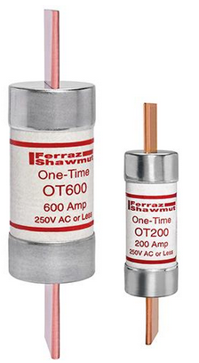
UL/CSA Class K5 Fuse Offering
  Rated 600A or less, 50kA I.R.
  Not Current-Limiting
  Sizes vary by ampere rating
  No rejection feature
  UL Listed for Branch-Circuit Protection
Series | Volts | Performance | Application
OT | 250VAC/DC | Fast-Acting | Feeders, branch circuits, resistive heating, residential and small commercial installations, HVAC
OTS | 600VAC / 300VDC

Slide 23
UL/CSA Class H Fuse Holders
20XXX & 60XXX
https://ep-us.mersen.com/products/series/class-hk-250v-fuseholders-class-h-k

Slide 24
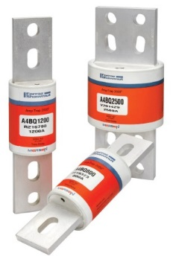
UL/CSA Low Voltage Fuse Offering
Class H (non renewable)
(248-6)
Class H (renewable)
(248-7)
Class C
(248-2)
Class CC
(248-4)
Class G
(248-5)
Class J
(248-8)
Class K
(248-9)
Class L
(248-10)

Slide 25
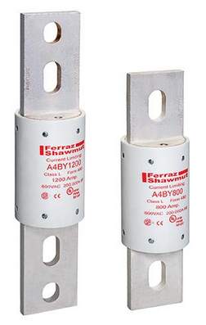
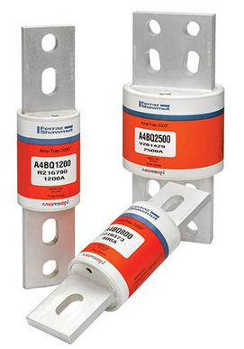
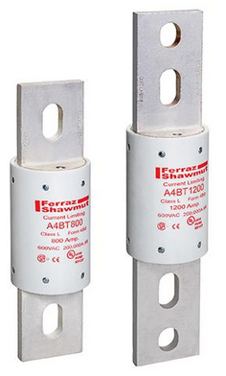
UL/CSA Class L Fuse Offering
  Rated 100-6000A (A4BQ), 200kA I.R.
  Current-Limiting
  Sizes vary by ampere rating
  Rejection by Size
  UL Listed for Branch-
  Circuit Protection
  Interchangeable by design
Series | Volts | Performance | Application
A4BQ | 600VAC/500VDC | Time-Delay | Mains, feeders, motors
A4BY | 600VAC/300VDC | Fast-Acting | Panelboard, loadcenter, switchgear
A4BT | 600VAC/500VDC | Time-Delay | Motors, transformers

Slide 26
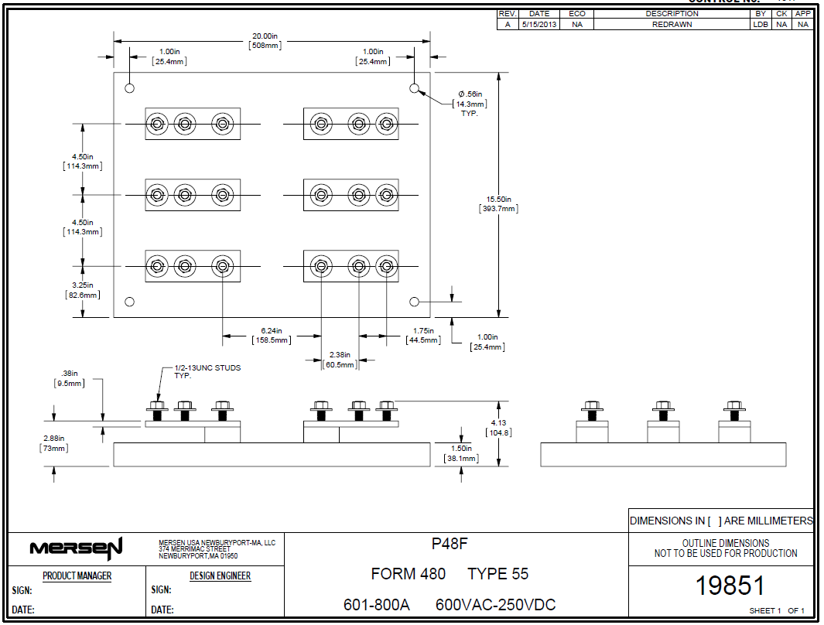
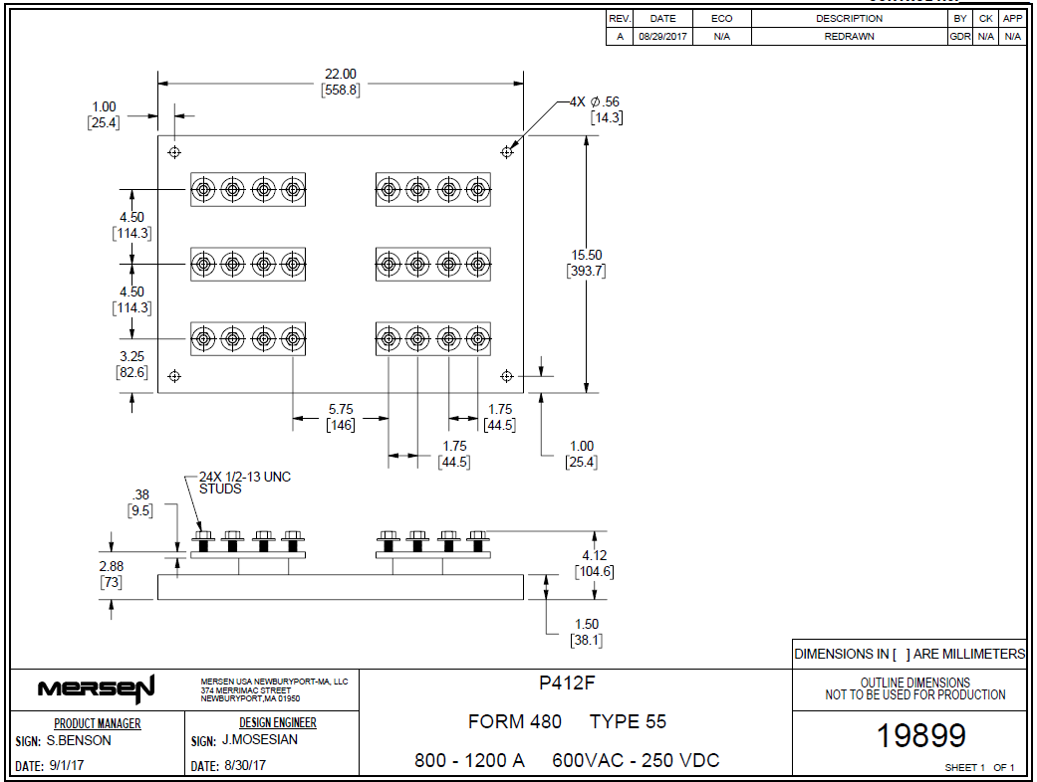
UL/CSA Class L Fuse Holders
P48F (100-800A)
P412F (800-1200A)

Slide 27
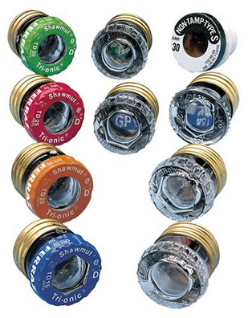
UL/CSA Low Voltage Fuse Offering
Class H (non renewable)
(248-6)
Class H (renewable)
(248-7)
Class C
(248-2)
Class CC
(248-4)
Class G
(248-5)
Class J
(248-8)
Class K
(248-9)
Class L
(248-10)
Plug Fuses
(248-11)

Slide 28
UL/CSA Plug Fuses
  Ratings Vary, Descriptions Vary
  3-30A, 10kA IR, AC
Series | Volts | Performance | Standard | Application
GP | 125VAC | Fast-Acting | CSA “P-Type” | Non-motor loads
GSL | 125VAC | Time-Delay | UL | Motor loads
GT | 125VAC | Time-Delay | UL “low temp” | Cycling loads & motor circuits
GTL | 125VAC | Time Delay | UL | Motor loads
GW | 125VAC | Fast-Acting | UL | Receptacle & Lighting
TD | 125VAC | Time-Delay | CSA “D-Type” | Electric Heating & cycling loads

Slide 29
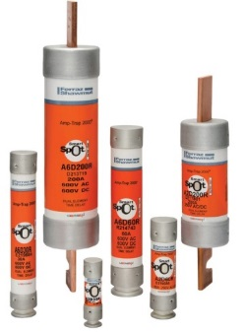
UL/CSA Low Voltage Fuse Offering
Class H (non renewable)
(248-6)
Class H (renewable)
(248-7)
Class C
(248-2)
Class CC
(248-4)
Class G
(248-5)
Class J
(248-8)
Class K
(248-9)
Class L
(248-10)
Plug Fuses
(248-11)
Class R
(248-12)

Slide 30
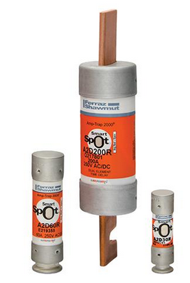
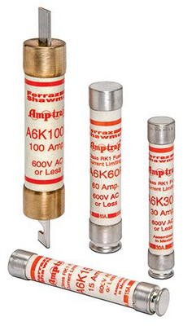
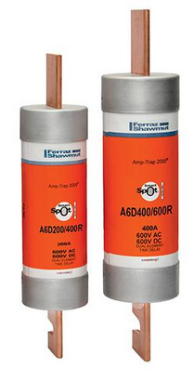
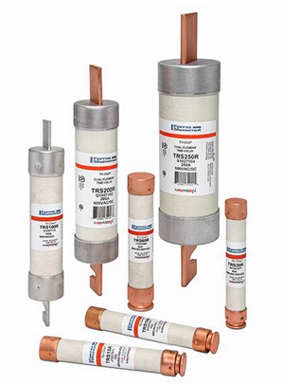
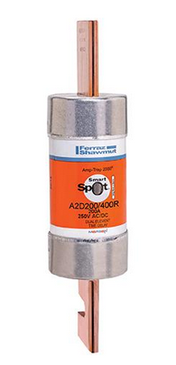
UL/CSA Class R Fuse Offering
  Ratings 600A or less, 200kA I.R.
  Current-Limiting
  Sizes vary by ampere rating
  Rejection feature
  UL Listed for Branch- Circuit Protection
  Non-indicating available in RK-5
  RK-1 Reducer fuses available in both 250VAC & 600VAC sizes
Series | Volts | Performance | Application
A2D-R | 250VAC/DC | Time-Delay (RK-1) | Motors, safety switches, transformers, disconnects, control, arc flash mitigation
A6D-R | 600VAC/DC
A2K-R | 250VAC | Fast-Acting (RK-1) | Loadcenters, panelboards, switchboards, bus duct, feeders, lighting
A6K-R | 600VAC
TR-R | 250VAC/DC | Time-Delay (RK-5) | Motor circuits, mains, feeders, branch circuits, transformers, service entrance
TRS-R | 600VAC/DC

Slide 31


UL/CSA Class R Fuse Holders
20XXXR & 60XXXR
https://ep-us.mersen.com/products/series/class-r-250v-fuseholders-class-r
https://ep-us.mersen.com/products/series/class-r-600v-fuseholders-class-r

Slide 32

Dead Front Covers - DFC
  Incorporate touch-safe protection
  into open style fuseholders
  Inexpensive, snap-on feature
  Optional visual blown fuse indication
  Available up to 100A
    Class J – (up to 200A)
    Class R
    Class CC
    Midget
    Class G

Slide 33

UL/CSA Low Voltage Fuse Offering
Class H (non renewable)
(248-6)
Class H (renewable)
(248-7)
Class C
(248-2)
Class CC
(248-4)
Class G
(248-5)
Class J
(248-8)
Class K
(248-9)
Class L
(248-10)
Semiconductor Fuses
(248-13)
Plug Fuses
(248-11)
Class R
(248-12)

Slide 34





UL/CSA Semiconductor Fuse Offering
  Rated 1-6000A Current-Limiting
  Rated 125 to 1500VAC/DC
  Sizes vary by ampere rating
  Different mounting options available
  Primarily used for back-up protection only
  Special purpose DC & AC fuses
  European Square Body
  North American Round Body

Slide 35




UL/CSA Semiconductor Fuse Holders
Open Style Blocks
Touch-Safe Holders
P-Blocks
Modular Blocks
https://ep-us.mersen.com/products/group/high-speed-fuse-bases-fuses-holders-and-accessories
https://ep-us.mersen.com/products/group/iec-cylindrical-fuse-links-and-fusegear
https://ep-us.mersen.com/products/group/high-speed-fuse-bases-fuses-holders-and-accessories
https://ep-us.mersen.com/products/group/high-speed-fuse-bases-fuses-holders-and-accessories

Slide 36

UL/CSA Low Voltage Fuse Offering
Class H (non renewable)
(248-6)
Class H (renewable)
(248-7)
Class C
(248-2)
Class CC
(248-4)
Class G
(248-5)
Class J
(248-8)
Class K
(248-9)
Class L
(248-10)
Semiconductor Fuses
(248-13)
Supplemental Fuses
(248-14)
Plug Fuses
(248-11)
Class R
(248-12)

Slide 37









UL/CSA Supplemental Fuse Offering
  Ratings Vary
  Physical dimensions vary
  Descriptions Vary
  UL Listed / Recognized for Supplemental Protection
  Other worthy mentions
Series | Volts | Performance | Application
ATQ | 500VAC | Time-Delay | Motors, transformers, lighting, control
ATM | 600VAC/DC | Fast-Acting | General purpose supplemental
TRM | 250VAC | Time-Delay | Motors, transformers, lighting, control
OTM | 250VAC | Fast-Acting | General purpose supplemental
DCT | 750VAC / 1000VDC | Semiconductor | Power electronics, DC traction, metering

Slide 38






UL/CSA Supplemental Fuse Holders
303 Series
USM Series
USGM Series
FEB/FEX Series
https://ep-us.mersen.com/products/series/303-series-midget-open-style-fuse-blocks-midget
https://ep-us.mersen.com/products/series/usm-midget
https://ep-us.mersen.com/products/series/usgm-midget
https://ep-us.mersen.com/products/series/feb-midget
GPM Series
Fuse Clips
https://ep-us.mersen.com/products/series/clips-cylindrical-fuses-ul-30a-and-60a-o-sizes-316in-14in-1332in-5mm-635mm-10mm
https://ep-us.mersen.com/products/series/gpm-series

Slide 39

UL/CSA Low Voltage Fuse Offering
Class H (non renewable)
(248-6)
Class H (renewable)
(248-7)
Class C
(248-2)
Class CC
(248-4)
Class G
(248-5)
Class J
(248-8)
Class K
(248-9)
Class L
(248-10)
Semiconductor Fuses
(248-13)
Supplemental Fuses
(248-14)
Plug Fuses
(248-11)
Class R
(248-12)
Class T
(248-15)

Slide 40


UL/CSA Class T Fuse Offering
  A3T rated 1200A or less, 200kA I.R.
  A6T rated 800A or less, 200kA I.R.
  Extremely Current-Limiting
  Sizes vary by ampere rating
  Rejection by Size
  UL Listed for Branch-
  Circuit Protection
Series | Volts | Performance | Application
A3T | 300VAC/160VDC | Fast-Acting | Loadcenters, panelboards, switchboards, metering centers
A6T | 600VAC/300VDC

Slide 41


UL/CSA Class T Fuse Holders
30XXXT & 60XXXT
https://ep-us.mersen.com/products/series/class-t-300v-fuseholders-class-t
https://ep-us.mersen.com/products/series/class-t-600v-fuseholders-class-t

Slide 42

UL/CSA Low Voltage Fuse Offering
Class H (non renewable)
(248-6)
Class H (renewable)
(248-7)
Class C
(248-2)
Class CC
(248-4)
Class G
(248-5)
Class J
(248-8)
Class K
(248-9)
Class L
(248-10)
Semiconductor Fuses
(248-13)
Supplemental Fuses
(248-14)
Plug Fuses
(248-11)
Class R
(248-12)
Class T
(248-15)
Test Limiters
(248-16)

Slide 43

UL Test Limiters (Umbrella Fuses)
  Available for class J, R, & L requirements
  Available for 50, 100, & 200kA testing
  Available from 100-4000A
  Pre-qualified as a test limiter
  Sizes vary by ampere rating
  UL Listed for use as a test limiter

Slide 44

UL/CSA Low Voltage Fuse Offering
Class H (non renewable)
(248-6)
Class H (renewable)
(248-7)
Class C
(248-2)
Class CC
(248-4)
Class G
(248-5)
Class J
(248-8)
Class K
(248-9)
Class L
(248-10)
Semiconductor Fuses
(248-13)
Supplemental Fuses
(248-14)
Photovoltaic
Fuses
(248-19)
Plug Fuses
(248-11)
Class R
(248-12)
Class T
(248-15)
Test Limiters
(248-16)

Slide 45




UL Photovoltaic (PV) Fuses
  600-1500VDC, up to 50kA I.R.
  1-400A, Sizes vary by ampere rating
  Crimp cap versions available
  UL Listed for PV applications only
Series | Volts | Size | Application
HP6M | 600VDC | 10x38mm | Combiner boxes, PV Strings
HP10M | 1000VDC
HP15M | 1500VDC | 10x85mm | Combiner boxes, PV Strings
HP6J | 600VDC | Class J dimensions | Combiners, Re-combiners, PV cable
HP10J | 1000VDC | Class J dimensions | Combiners, Re-combiners, PV cable
HP10NH | 1000VDC | NH1, NH2 | Combiners, Re-combiners, PV cable
HP12NH | 1200VDC | NH 1XL, 2XL, 3L | Combiners, Re-combiners, PV cable
HP15NH | 1500VDC | NH 1XL, 2XL, 3L | Combiners, Re-combiners, PV cable

Slide 46





UL Photovoltaic Fuse Holders
HP15FHM32
HP10J Blocks
NH Fuse Bases
https://ep-us.mersen.com/products/series/fuse-bases-nh-gpv-photovoltaic-fuse-links
https://ep-us.mersen.com/products/series/hp15fhm32-helioprotectionr-fuse-holders-pv-applications
https://ep-us.mersen.com/products/series/helioprotectionr-hp10j-fuses-photovoltaic

Slide 47




Medium Voltage Fuse Offering
  E-rated Fuses for overload and Short-circuit protection
    2.4 to 38kV
    1/2A to 1200A
    Different mounting options
    Indoor/outdoor rated
  R-rated fuses for back-up protection only
    2.5 to 15.5kV
    2R to 36R
    Different mount options

Slide 48



Medium Voltage Fuse Offering
  IEC DIN Style Back-up fuses
    6 to 36kV
    2A to 250A
    Meet DIN size requirements
  Potential Transformer Fuses (PT)
    0.625V to 15.5kV
    1/2A to 10A
  Capacitor Fuses
    1kV to 5.5kV
    12A to 200A
    Ampere rating varies by size
    Different mounting options

Slide 49



Medium Voltage Supports and Disconnects
Supports and Disconnects
Live Parts

Slide 50



UL Low Voltage Disconnects
  UL508 Non-Fused Disconnects
    600VAC
    20 to 80A
    Suitable for use as a motor disconnect
    Din-rail or panel mount
  UL98 Non-Fused Disconnects
    600VAC
    30 to 1200A
    Rated for service entrance or main panel
  UL98 Fused Disconnects
    600VAC
    30 to 1200A
    Rated for service entrance or main panel
    Rated for use with Class CC, J, or L fuses

Slide 51


Mersen’s Wire Management Product Offering
  MPDB Series
    600VAC/1000VDC
    UL listed to 1953
    Some part numbers rated for high strand cable & multiple conductors
    3-different frame sizes; small, intermediate, large
    Option hinged safety cover
    Double wide and triple wide blocks available
  FSPDB Series
    600VAC/1500VDC
    UL Recognized
    Touch-safe by design
    Offered as single poles with the ability to join as multipoles
    FSPDB1-3 are din-rail mountable

Slide 52

Mersen’s Wire Management Product Offering
  Compact PDB Series
    600VAC/DC
    UL Recognized
    Rated for use with smaller gauge wire, down to 18AWG
    Multiple conductors
    Rated for use with DLO
    3-different frame sizes; small, intermediate, large
    Din-rail or panel mount options

Slide 53





Electric Vehicle & Energy Storage
Battery Module Fuse
EV Pack Fuses
EES gBAT Fuses
Series | Volts | Ampere range | Application
MF | 100VDC | 50-200A | EV & EES, battery module
MEV100 | 1000VDC | 8-600A | EV & EES, battery pack
MEV70 | 700VDC | 35-600A | EV & EES, battery pack auxiliaries
MEV55 | 550VDC | 5-50A | EV & EES, battery pack auxiliaries
GBAT | 1500VDC | 50-400A | Energy Storage

Slide 54








Engineered Products Cooling/Busbar
  Cooling
  Bus Bar
  Air and Liquid Cooled Heatsinks
  Heat-pipe Assemblies
  Heat Exchangers
  Enclosed Cooling Systems
  Laminated / Multi-layer
  Flexible / High Temperature
  Powder Coated

