Slide 1
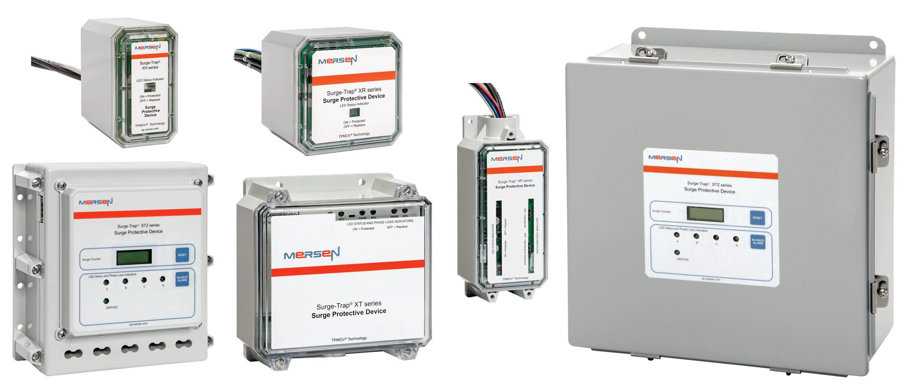
Surge Protection:
Technical Background & Basics

Slide 2

Surge Protection – Agenda
Introduction
AC Power Basics
Power Quality Scope
Voltage Transients & Disturbances
Power Quality in the Workplace & the Effects of Transients
MOV Technology & Surge Protective Devices
Notes:
In this training module we will cover the items listed here.
We’ll begin with an introduction in AC power basics and we will finish with surge protection devices especially the M.O.V. technology.

Slide 3
Course Objectives
Describe the risk that voltage surges pose for today’s electronic equipment
Explain the basics of AC power
Explain types of voltage disturbances
Discuss various surge protection devices
Notes:
The objectives of this training module on are to:
-Describe the risk that voltage surges pose for today’s electronic equipment,
-Explain the basics of AC power,
-Explain types of voltage disturbances, and
-Discuss various surge protection device technologies
This module serves as the foundation for all surge protection modules.

Slide 4
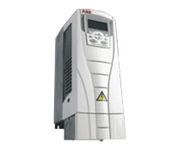
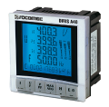
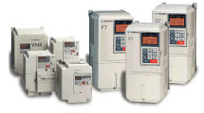
Progression of Electronic Devices
Overall Size
Electronic Usage
Time
Use of electronic equipment has increased
Overall size of the equipment has decreased
Smaller more compact electronic devices have become more susceptible to over-voltage failures
Notes:
Over the years, the use of electronic equipment has increased significantly throughout the facility. As society continues to develop leading edge technologies, the technology has gotten smaller & more powerful allowing the equipment to get smaller and smaller. However, smaller, more compact electronic devices are more sensitive to changes in voltages and currents. It is important to recognize that these electronic devices have more potential exposure to overvoltage failures than ever before in previous history.

Slide 5
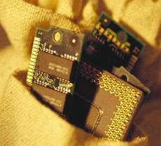
Microprocessor Electronics
Microprocessor driven devices can be found in almost every commercial, industrial and residential setting, for example:
  Computer Networks, diagnostic equipment, alarm sensors, CNC machines, etc…
Integrated circuit chips are especially sensitive to transient voltage surges due to their:
  Microscopic size & structure
  Extremely low operating voltages
  Increased switching speeds
Notes:
The smaller and more intelligent your electronic devices get, the more they rely on microprocessor devices. These devices can be found in almost every commercial, industrial, and residential setting. For example, computer networks, C. N. C. machines, telecom equipment, scanners, and alarm systems are just a few. The image to the lower left is a PC memory card for your home or office computer. Devices, such as these PC memory cards, incorporate integrated circuit chips which are especially sensitive to transient voltage surges due to their microscopic size and structure, their extremely low operating voltages, as well as their increased switching speeds. As our computers and other electronic devices become faster and more reliable, they become more vulnerable to voltage surges.

Slide 6
A Perspective of Facility Downtime
Facility downtime costs commercial and industrial plants nearly
$26 billion a year in lost time, equipment repair, and replacement
Notes:
The top graph represents the estimated downtime attributed to power quality issues. Note that since the development of the computer, the percentage of downtime in a facility has grown significantly. As facilities increase their usage of these electronic devices they neglect to upgrade their power quality infrastructures. It is estimated that 55 percent of all facility downtime is attributed to power quality.
Now let’s associate a dollar amount to a typical facility downtime incident. By analyzing the bottom bar graph, we can see the estimated downtime per incident per industry. As you can see, the automotive industry has an average downtime of less than twenty minutes per incident while the steel and aluminum industry has an estimated downtime of one hour per incident. By analyzing this bar graph we can see how much money each industry looses per hour per incident. For example, the steel and aluminum industry will loose two million dollars per hour of downtime. It is estimated that nearly 26 billion dollars per year is lost in downtime incidents.

Slide 7
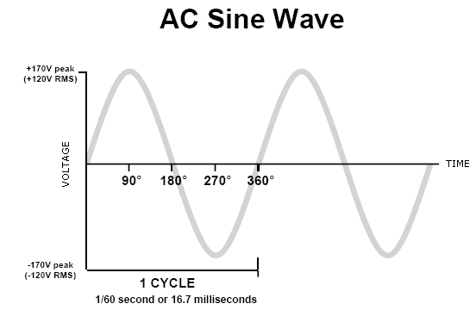
AC Power Basics
North American Power Generation Facilities supply alternating current (AC) power
AC frequency is 60 cycles per second or 60Hz
Notes:
In order to understand surge protection devices and how they operate we should review some standard power basics. The figure shown is an ideal AC sine wave. The amplitude of the sine wave is also known as the voltage peak. In this case our peak voltage is 170 volts. To obtain the R. M. S. voltage we would multiply the peak volt by point 7. In this case, it reveals 120 volt
R. M. S. AC voltage. The period of a sine wave is the amount time it takes for the sine wave to complete one revolution. In this case, it takes 16 point 7 milliseconds for the sine wave to complete one revolution. To obtain the frequency we use the formula, one divided by the period. In this case, one divided by 16 point 7 milliseconds yields a frequency of 60 cycles per second or 60 hertzs. It is important to understand that all North American power generation facilities supply AC power at 60 cycles per second.

Slide 8
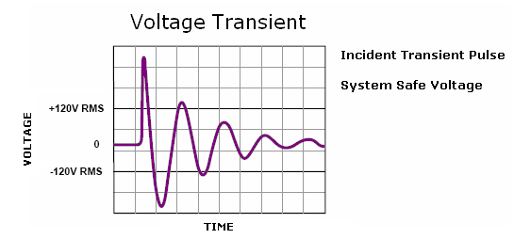
What is a Voltage Surge?
High amplitude, short duration overvoltage
  Any voltage level that is short in duration and is also 10% greater than the systems normal operating AC, RMS or DC voltage level.
  A voltage surge is also known as a voltage transient.
Notes:
So what is a voltage surge? A voltage surge is any voltage level that is short in duration and is also 10 percent greater than the system’s normal operating AC, R. M. S. or. D. C. voltage level. A voltage surge is also known as a voltage transient. By studying the graph, we can see an incident transient pulse well above the systems safe voltage of 120 volts. This pulse is also in short duration.

Slide 9
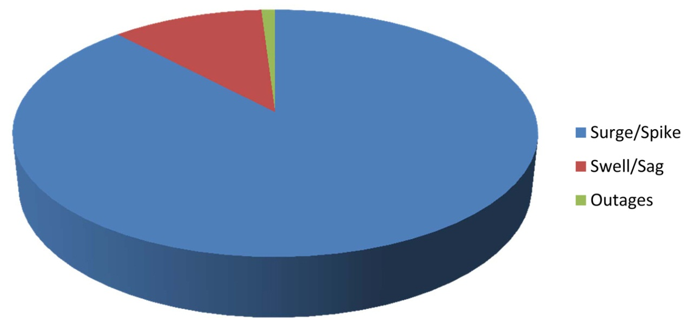

Types of Voltage Disturbances
The most common
voltage disturbance
is a surge or spike
in voltage
Less common types
of disturbances are:
  Swell – An increase in
  the power frequency AC
  voltage with durations from
  one half cycle to a few seconds
  Sag – A rms reduction in the power frequency AC voltage with durations from one half cycle to a few seconds (also known as dip)
Allen-Segal IBM Study
Notes:
Voltage surges account for 88 percent of all voltage disturbances. 11 percent is attributed to swells and sags and only one percent is attributed to voltages outages or blackouts. The difference between a voltage surge and a swell or a sage is that a voltage surge is very short in duration whereas a swell or a sage usually takes one half cycle to a few seconds.

Slide 10
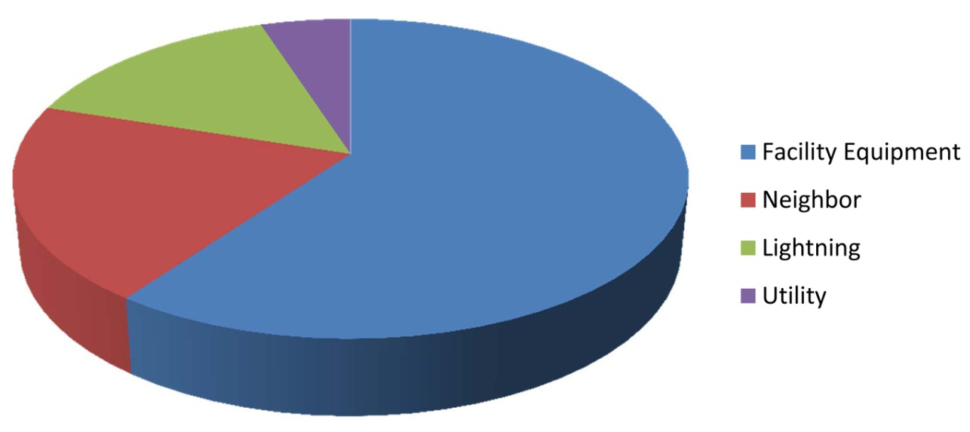
Power Quality Problems
Sources of Power Quality Problems in the Business Place
Florida Power Study
There are two general causes of voltage surge
  Natural causes (lightning)
  Other causes due to equipment or switching devices
    Utility switching
    Facility equipment due to switching in your facility, your neighbors facility or at the utility company
Notes:
So what are the sources of these power quality problems? Well, ironically, 60 percent of all power quality problems originate from within the facility. 20 percent is due to your neighbor’s facility. While 5 percent is due to the utility switching on and off the grid and 15 percent can be attributed to lighting. Overall, there are only two possible causes for a voltage surge: the first one being natural causes such as lightning and the second one being other causes due to equipment from within your facility or your neighbor’s facility or utility switching devices.

Slide 11

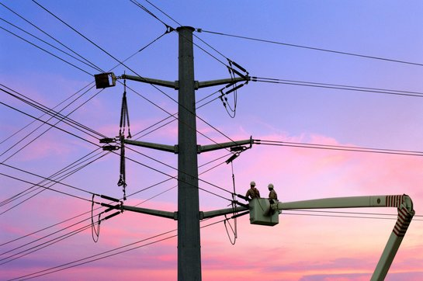
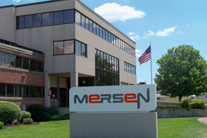
Natural Causes (Lightning)
Initial direct or indirect strike
Travels through power
lines or ground
Enters your facility
Direct lightning strikes
  Can be the most damaging
Indirect lightning strikes
  Indirect lightning strikes up to 30 miles away can still affect your facility
Notes:
Surges are frequently associated with lightning strikes so it is important to discuss this topic. Lighting can be divided into two categories: direct lightning strikes and indirect lighting strikes. Direct lighting strikes can be the most damaging event. A direct lightning strike is when lightning strikes a lightning conductor, the roof of a building, or a low voltage overhead power line. Indirect lighting strikes are lighting that strikes within the vicinity of a building. Indirect lighting strikes up to 30 miles away can still have an affect on your facility

Slide 12
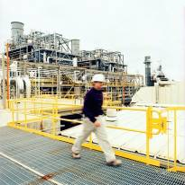
Causes Due to Equipment Switching
Type 1: Utility Switching
Utility Grid Switching
Travels through power
lines or ground
Enters your facility
Type 2: Facility generated
Generated from within your facility
Switching of large transformers, motors, and other inductive loads can generate spikes or transient impulses
Notes:
There are also potential surges that can be attributed to equipment switching. Switching can occur either from the utility or from equipment from within your facility. These surges are typically due to the switching of large transformers, motors, or other inductive loads which can generate spikes or transient impulses

Slide 13
Harmful Effects of Transient Surges
The most common failures produced by transients within electronic devices are:
  Disruptive effects – Encountered when a voltage transient enters an electronic component and the component then interprets the transient as a valid logic command, resulting in system lock-up, malfunctions, faulty output or corrupted files
  Dissipative effects – Associated with short duration repetitive energy level surges, resulting in long-term degradation of the device
  Destructive effects – Associated with high level energy surges, resulting in immediate equipment failure
Notes:
Now that we understand the sources of transient voltages, what are the effects?
The most common failures produced by transients within electronic devices are the following, also known as the three Ds.
Disruptive effects. These are usually encountered when a voltage transient enters an electronic component. The electronic component then reads this voltage as a logic command, resulting in system lockups, malfunctions, faulty outputs, corrupted, or deleted files.
Dissipative effects are usually associated with short duration repetitive energy level surges resulting in the long range degradation of the device.
Finally, destructive effects associated with high level energy level surges resulting in immediate equipment failure.

Slide 14
Surge Protective Device (SPD)
A surge protective device, or SPD, reduces the magnitude of a voltage transient surge thus protecting equipment from damaging effects. SPDs were commonly known in the past as TVSS (Transient Voltage Surge Suppressor)
A SPD tries to:
  Send surge away (to ground)
  Acts as a momentary ‘short circuit’
    ‘short circuit’ ≈ voltage equalization ≈ no overvoltage ≈ protected load
Notes:
To protect equipment from transient voltages, a surge protection device can be installed. A surge protection devices or SPD (S-Pee-Dee) reduces the magnitude of a voltage transient thus protecting the equipment from their damaging effects. An alternate term used in the past for a surge protection was transient voltage surge suppressor or TVSS (Tee-Vee- S-S)
A SPD’s function is to either send the surge to ground, rerouting the potential damaging effects away from the equipment or to act as a momentary short circuit. By acting as a short circuit, the voltage is equalized, no overvoltage occurs and the load is protected.

Slide 15

How a SPD Works
Transient
Voltage
SPD
SPD Shunt Path
The SPD acts as a pressure relief valve
The pressure relief valve (SPD) does nothing until an over-pressure pulse (voltage surge) occurs in the water (power) supply
Notes:
The following diagrams will help illustrate how an S. P. D. works. The image to the left shows a water wheel application. The water is fed through to the wheel through a small pipe. If there were ever to be a buildup in water pressure, the check valve would open and release the excess water. In the electrical example, the surge protective device acts as the check valve or the pressure release valve. As the voltage level rises, the excess voltage is drawn through the S. P. D., protecting the electronic equipment in parallel with the device. Similar to the check release valve, the S. P. D. does not function until there is an over-voltage present.

Slide 16
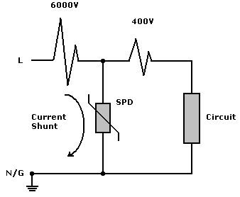
Term to Know: “Clamping”
Clamping describes the process by which an SPD reduces voltage transients and surges to a specified lower voltage level suitable for the protected load
Voltage Surge
Residual Voltage
(Let-Through Voltage)
* Images from slides 6, 7 and 16 taken from Leviton Technical and Applications Module for Power Quality Products
Notes:
A key term to know when dealing with surge protective devices is clamping. Clamping is a term used to describe the process by which an S PD reduces voltage transients to a specified lower voltage suitable for the protective load. In the figure below, the SPD is connected in parallel with the load and there is a voltage surge present of six thousand volts. The S PD acts as a check release valve and creates a shunt path for the excess voltage to follow. Any voltage that gets by the surge protective device is also known as residual voltage or let-through voltage. In this case, we had a voltage surge of six thousands volts and a let-through voltage of four hundred volts.

Slide 17




Types of SPD Technologies
Metal Oxide Varistors (MOV) | Contains a ceramic mass of zinc oxide grains, combined with other metal oxides sandwiched between two metal plates forming a network of back-to-back diode pairs
Silicon Junction Diode | The diode is installed reverse-biased under normal conditions. When the voltage rises above normal conditions the diode becomes forward-biased
Spark Gap | If a voltage surge is experienced a spark ignites gases creating an arc across the gap
Gas Tube Arrestor | Commonly used for telephone lines as they enter a building Sophisticated spark gap that safely shunts the surge to ground
Notes:
There are several different types of surge protection device technologies, of which the four most common technologies are represented in this table. The first is the M. O. V. or the Metal Oxide Varistor. The M. O. V. is the most popular and best performing S. P. D. technology available. The M. O. V. contains a ceramic mass of zinc oxide grains, combined with other metal oxides sandwiched between two metal plates forming a network of back-to-back diode pairs. The second technology is the silicone Junction Diode. The diode is installed reversed biased under normal conditions. When the voltage rises above normal conditions, the diode becomes forward biased creating a shunt path to ground. The third technology is the Spark Gap. The Spark Gap is usually a gas tube filled with either gas or air with a gap between two conductors. When an over-voltage is seen, a spark ignites an arc between the two conductors creating a shunt path to ground. The final technology is the Gas Tube Arrestor. This technology is commonly used for telephone lines as they enter a building and is essentially a sophisticated Spark Gap. Early in the industrial industry, spark gaps and gas tube arrestors were more common. In today’s technologically advanced industry, the M. O. V. is the most commonly used S. P. D. technology.

Slide 18
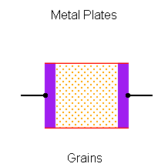
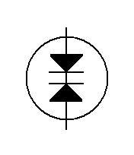
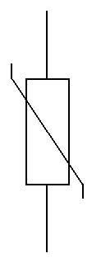
MOV Technology
Contains a ceramic mass of zinc oxide grains combined with small quantities of bismuth, cobalt and manganese sandwiched between two metal plates
The boundary between each grain and its neighbor forms a diode junction, allowing current to only flow in one direction
Equivalent to a mass of back-to-back diode pairs, each in parallel
Schematic Symbols
Notes:
The M. O. V. technology is the most durable and reliable technology available. As previously mentioned, the M. O. V. contains a ceramic mass of zinc oxide grains combined with a small quantity of bismuth, cobalt, and manganese which are all sandwiched between two metal plates. The boundary between each grain and its neighbor forms a diode junction allowing current to only flow in one direction. Since there are thousands of these junctions inside an M. O. V., it is equivalent to a mass of back to back diode pairs each in parallel. The image to the upper left is a cross-sectional diagram of an M. O. V. showing the internal grains sandwiched between two metal plates. The lower left image is an example schematic of the M. O. V. symbols.

Slide 19
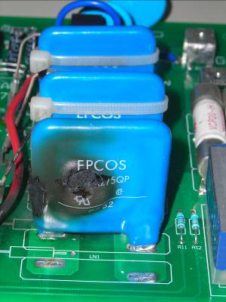
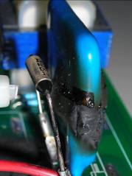
MOV Failure Modes
There are two types of MOV failure modes:
  High energy over-voltages
  Lower energy repetitive pulses
Notes:
There are two types of M. O. V. failure modes. The first failure mode is a high energy over-voltage. The second volt failure mode is a low energy repetitive pulse. The images on this page show an M. O. V. which was subject to a high-energy over voltage for a long duration of time.

Slide 20
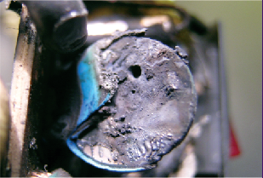
MOV Failure due to High Energy Over Voltages
Event: Large single energy event spike or transient beyond the rated capacity of the device
  Failure: Device will rupture or explode
Event: Sustained over-voltage condition building up energy
  Failure: Device will go into thermal overheating and rupture (thermal overload)
Event: Repeated lower level spikes or transient over-voltage conditions
  Failure: Device will slowly degrade until failure
Due to the destructive nature of this failure surge rated fuses are required for all MOV installations. (Except TPMOV®)
Every time an MOV switches, its life is slightly degraded. The greater the transient hit,
the greater the degradation of the MOV
Notes:
While examining an M. O. V. failure due to high energy over voltage we can suggest two events. Event 1: a large single energy event spike or transient beyond the rated capacity of the device. The failure mode will be the device will rupture or explode. Event 2: a sustained over voltage condition building up energy. This is also known as a thermal overload condition. The device will go into thermal runaway or overheating and rupture or explode. Due to the destructive nature of this failure, surge rated fuses are required for all M. O. V. installations except, of course, four our TP M. O. V. The image on this page is an M. O. V. which experienced a thermal overload.
The second failure mode results from low energy repetitive pulses. For this case, the event may be a repeated lower level spike or transient over voltage condition. In this case, the failure mode will be the device will slowly degrade until complete failure. Every time an M. O. V. switches, its life degrades slightly. The greater the hit, the greater the degradation of the M. O. V. One hit of 10 K A may degrade the M. O. Vs. life just as much as 20 hits of point 2 K A. Unlike the high energy failure, there is no external indication of this failure mode. Once the M. O. V. fails, it will act as a short with high resistance

Slide 21
Contact Mersen for Surge Protection
Solutions & Products
Email: info.nby@mersen.com
Call: 978-462-6662
Web: ep.mersen.com
Notes:
This concludes training on Surge Protection: Technical Background and Basic Information. You should now be able to:
-Describe the risk that voltage surges pose for today’s electronic equipment,
-Explain the basics of AC power,
-Explain types of voltage disturbances, and
-Discuss various surge protection device technologies
In order to complete this module, you must successfully pass the brief quiz associated with it. You may review the material in this course again. When you are ready, please proceed to the quiz.
It is recommended that you complete the quiz associated with this module before proceeding to subsequent surge protection training modules.

